Slide 1
Exploring touch, speech and motion interfaces for android apps

Slide 2
Contents
Android OS
How Android handles inputs
How the Android Touch Screen Works
Speech API
Motion Senor API
Simplistic Game
Further Improvements

Slide 3
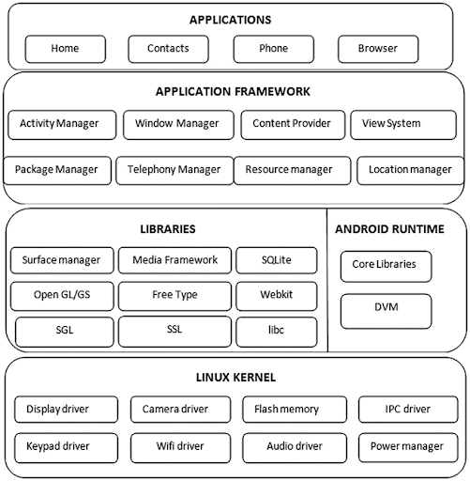
The Android Operating System
Android OS is a Layered Environment consisting of the following layers :
Linux Kernel : This layer consists of all the device drivers, sensors, etc.
Hardware Abstraction Layer : This layer provides standard interfaces for all the hardware components. This helps to standardize the inconsistent hardware settings in different devices
Native C/C++ Libraries and Android Runtime: Core components such as HAL and ART are coded in C/C++, then Java APIs are provided to expose the functionality of the Libraries
Java API framework : All the features of android OS are available as Java APIs
Applications : The desired functionality of the app is built using the Java APIs

Slide 4
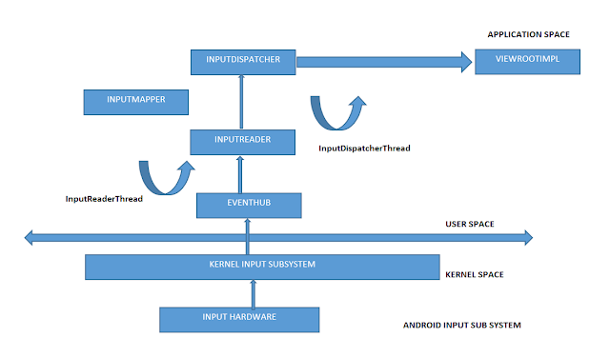
How android handles inputs?
The Android input system consists of an event pipeline traversing many layers of the android system.
dispatchTouchEvent() API
onTouchEvent() API

Slide 5
How android handles inputs?
At the lowest layer, the physical input device produces signals that describe state changes such as key presses and touch contact points. The device firmware encodes and transmits these signals in some way such as by sending USB HID reports to the system or by producing interrupts on an I2C bus.
The signals are then decoded by a device driver in the Linux kernel. The Linux kernel provides drivers for many standard peripherals, particularly those that adhere to the HID protocol. However, an OEM must often provide custom drivers for embedded devices that are tightly integrated into the system at a low-level, such as touch screens.
The input device drivers are responsible for translating device-specific signals into a standard input event format, by way of the Linux input protocol. The Linux input protocol defines a standard set of event types and codes in the linux/input.h kernel header file. In this way, components outside the kernel do not need to care about the details such as physical scan codes, HID usages, I2C messages, GPIO pins, and the like.
Next, the Android EventHub component reads input events from the kernel by opening the evdev driver associated with each input device. The Android InputReader component then decodes the input events according to the device class and produces a stream of Android input events. As part of this process, the Linux input protocol event codes are translated into Android event codes according to the input device configuration, keyboard layout files, and various mapping tables.
Finally, the InputReader sends input events to the InputDispatcher which forwards them to the appropriate window.

Slide 6
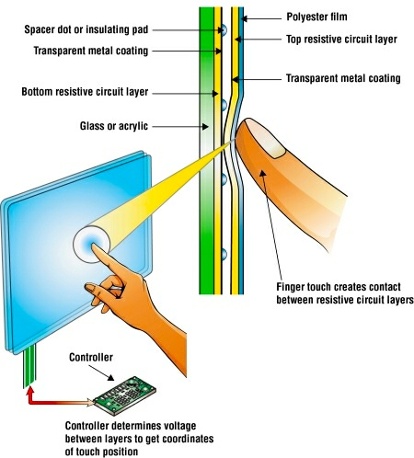
How android Touch screen works?
The phone screen consists of the following layers at the top.
Polyester Film : This layer is exposed to us
Positive Metal Film: This layer has the excess positive charges generated due to electric field of the electrons in the inner layer
Insulating Film: Acts as Insulator between the positive and the negatively charged Metal films
Negative Metal Film: Has excessive negative charges, forms the negative plate of the capacitor.
When any conducting material like our finger touches the glass, the electric field un the region is distorted and the positive charge is transferred to out fingers. This creates a temporary charge deficiency in the region where we touch , this touch is detected by the hardware devices which triggers the necessary operations. The charge density is checked frequently to handle multiple touches

Slide 7
Event stack on click operation
Touch Event Triggered: When the user touches the screen, the touch event is triggered. The activity’s view, also known as DecorView in Android, receives the touch event notification first.
Dispatch Touch Event: The touch event is then dispatched from the DecorView to the ViewGroup. This is done using the dispatchTouchEvent() method. The ViewGroup in Android transfers the touch event from top to bottom in the ViewGroup hierarchy to its children.
Intercept Touch Event: The touch event is intercepted within the ViewGroup using onInterceptTouchEvent(). If onInterceptTouchEvent() returns true, the touch event is not passed to its children; if it returns false, the Android eco-system is notified that the ViewGroup wants to dispatch the event to its children.
Handle Touch Event: The last view in the view tree (in this case, the button) receives the touch event. The onTouchEvent() method is triggered, and depending on the type of touch event (such as ACTION_DOWN, ACTION_MOVE, or ACTION_UP), different actions are performed.
Event Handling: The handling of the event is all about the priority assigned to everything, the first, and then it moves towards the ViewGroups. Touch events function similarly to event dispatching, but in reverse order from child to parent.

Slide 8
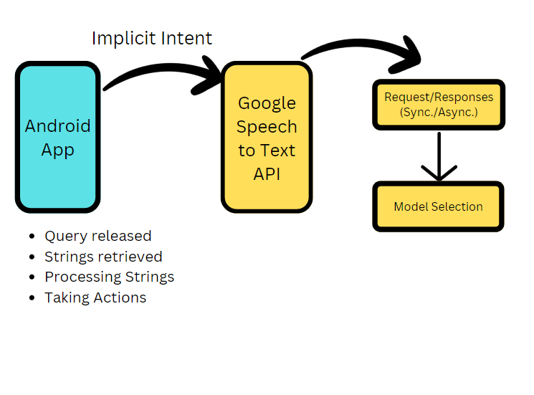
Integrating the speech feature
The Game basically consists of 2 Activities : The Google Speech API and the main game Page. Communication is established between these activities using Intent Protocol, described as below.

Slide 9
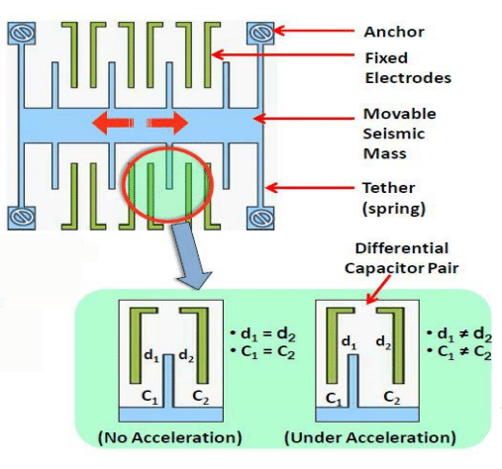
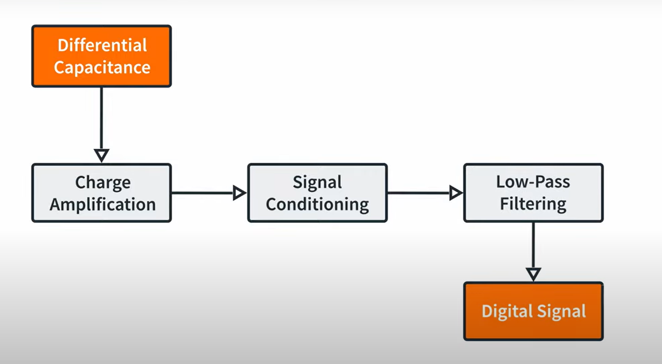
How motion sensing works
The internal circuits of the accelerometer consists of the structures shown on the left.
Seismic Mass is a movable metal comb like structures which moves with acceleration. This mass develops a capacitance with the fixed electrodes which does not change when there is no acceleration.
When there is an acceleration in a particular direction, the capacitance changes leading to a differential capacitance being developed.
This differential Capacitance Signal is Identified and pre- processed to be converted into a digital signal which can be caught by the device drivers.

Slide 10
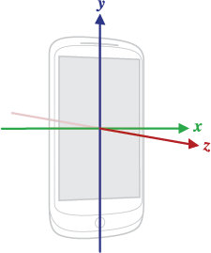
Integrating Motion sensing feature
The MainActivity class implements the SensorEventListener interface implemented in the “android.hardware” library. This interface is used to detect changes in Sensors via SensorManagers.
The SensorEvent class has the data of the Sensor being used, and its activities, like the accuracy, timestamp etc. and the SensorManager calls grants us the access of all the sensors.
The desired functionality is achieved by Overriding the standard interface functions of the SensorEventListener according to our need.

Slide 11
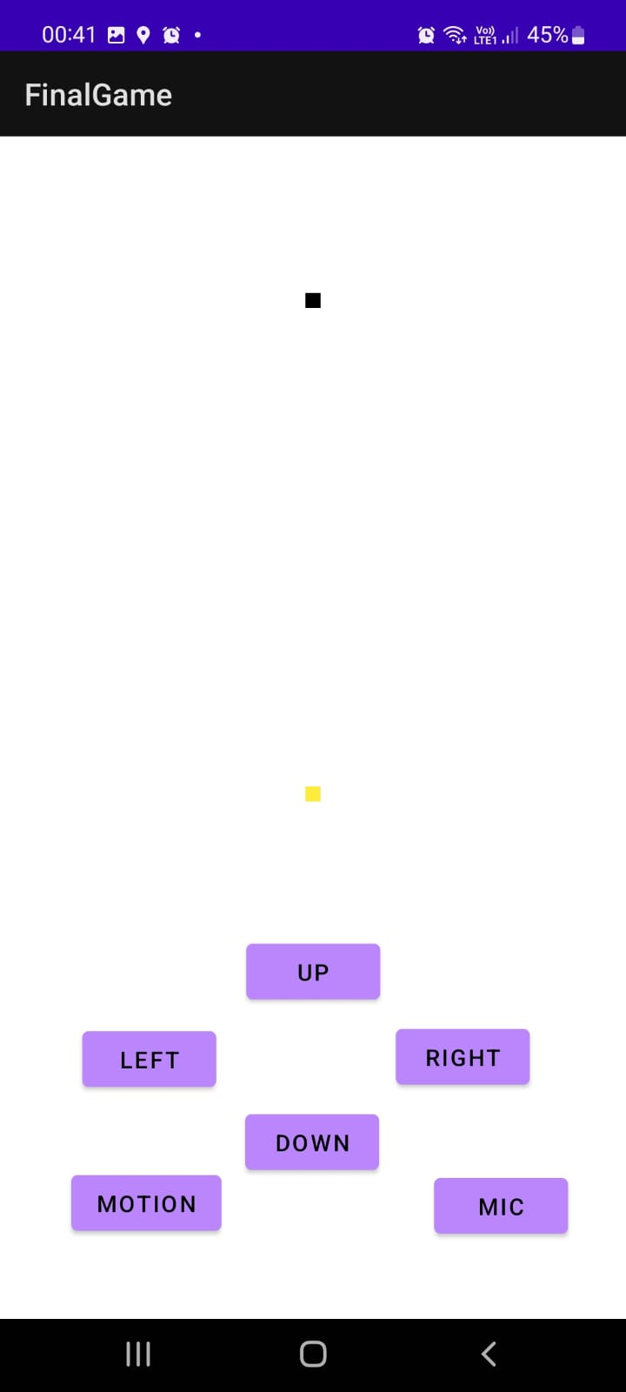
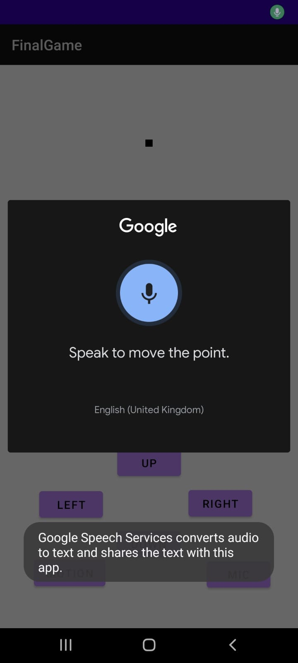
A simplistic game
Designed a Simplistic game, to understand how a fundamental UI element – Button works
The game basically involves a black point which has to chase the yellow point, the user can move the black point using the 4 buttons.
Every time, the black point comes in close vicinity of the yellow point, the yellow point jumps to a new random position and the black point has to chase it again.
The onClickListener() Java API is used to program the button to achieve the desired functionality,
When the user taps the screen, the touch is detected by the device drivers and in the subsequent process, the onClickListener API is called to carry out the desired task.

Slide 12
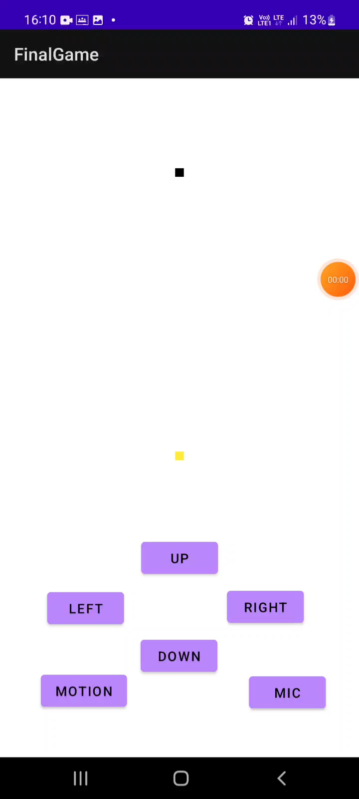
A simplistic game
Designed a Simplistic game, to understand how a fundamental UI element – Button works
Also, speech input functionality was added to the code, to enhance user experience.
By Tapping the mic button, the user can speak relevant commands like “Go Up….” , “Move Right….” etc.
On successful recognition of the command, the operation is carried out and the point is moved.

Slide 13
Scope for improvement – llm(s)
In this game, the speech input is taken and converted to text, and trivial commands like “Up”, “Down” are executed through speech inputs.
LLMs can greatly enhanced the accessibility of the app, reducing the need to actually touch the screen to carry out various actions.
For ex. In this app , if the user speaks “Go Up by 5 units”, the processing in this game is such that the presence of “Up” word in the screen is detected and the point only moves up by 1 unit. This is not what the user expected.
So, adding another LLM layer in the speech feature architecture can enhance the accessibility o the app. This will be even more relevant in complex applications.

Slide 14
References
Android Input Pipeline : https://source.android.com/docs/core/interaction/input
Speech Recognition Package : https://developer.android.com/reference/android/speech/package-summary
Intent Protocol : https://developer.android.com/reference/android/content/Intent
Speech To Text in Android : https://medium.com/@andraz.pajtler/android-speech-to-text-the-missing-guide-part-1-824e2636c45a

Slide 15
Thank you
Rhythm Patni
B22CS043
b22cs043@iitj.ac.in

